Slide 1
Fraud Detection
Capstone
Elton Loo

Slide 2
Problem Statement
With the rise of technology, online transactions are more prevalent. This has opened new avenues for criminals to exploit vulnerabilities in the digital landscape.
Eventually, there will be more companies that would need help to identify the fraudulent transactions.
Notes:
Exponential growth of technology
Online transactions through creditcard, paypal or other forms of payment
Examples like shoppee, Lazada , Taobao

Slide 3
Objective
We aim to develop a machine learning model to help accurately identify fraudulent online transactions, ensuring companies to be able to minimize financial losses and enhance security in a digital world.
Notes:
Our objective for this project is to create a fraud detection system, that can help identify fraud transaction
Accurately identify most fraud cases
Avoid flagging too many legitimate transactions

Slide 4
Project Process
EDA
Feature Engineering
Model Development
Model Evaluation
Clean data, analyze fraud patterns, and select key features for modeling.
Create new features to capture fraud patterns and prepare data for modeling.
Build and train machine learning models to predict fraudulent transactions.
Evaluate model performance and deploy the best model for fraud detection.

Slide 5
Exploratory
Data Analaysis
&
Feature Engineering

Slide 6
Data Dictionary
Features / Data type | Description
Step - int64 | Maps a unit of time in the real world. In this case 1 step is 1 hour of time. Total of 744 steps(31 days simulation).
Type - object | 5 Categories, CASH-IN, CASH-OUT, DEBIT, PAYMENT and TRANSFER
Amount - float64 | Amount of the transaction in local currency.
nameOrig - object | Customer who started the transaction
oldbalanceOrg - float64 | Initial balance before the transaction
newbalanceOrig - float64 | New balance after the transaction.
nameDest - object | Customer who is the recipient of the transaction
oldbalanceDest - float64 | Recipient’s balance before the transaction (missing for merchants).
newbalanceDest - float64 | Recipient’s balance after the transaction (missing for merchants).
isFraud - int64 | Marks transactions by fraudulent agents (1 = fraud, 0 = not fraud).
isFlaggedFraud - int64 | Flags transactions exceeding 200,000 in a single transfer (1 = flagged, 0 = not flagged)..

Slide 7
Dataset
Synthetic Financial Dataset For
Fraud Detection
Data
Limitations
Assumptions
6,362,620 rows
Data set is only a 31 days period
Most companies have similar financial dataset
11 features
Lack of transaction location data
Only one type of fraud
8213 Fraud cases (0.13%)
It is also the target variable

Slide 8
Features Relationship
Amount
Merchant
Individual
The amount is related to all transaction values (e.g., oldbalanceOrg, newbalanceOrig, oldbalanceDest, newbalanceDest).
If the recipient is a merchant, there will be missing values
(e.g., oldbalanceDest, newbalanceDest
Steps – To be converted to days
Type - CASH_OUT, TRANSFER, DEBIT, PAYMENT
IsFraud – Target Variable

Slide 9
Data Dictionary – Feature Engineered
Feature Engineered/Data type | Description
days - int64 | Day of the month (1 to 31)
days_binned - category | Groups days into ranges (e.g., 0–5, 5–10) for easier analysis.
is_merchant_dest - bool | Binary indicator (1 if the destination account is a merchant, 0 otherwise)
balance_change_orig - float64 | Change in the origin account balance (newbalanceOrig - oldbalanceOrg)
balance_change_ratio_orig – float64 | Ratio of balance change to sender’s original balance.
is_account_drained - bool | Binary indicator (1 if newbalanceOrig == 0, 0 otherwise)
real_balance - float64 | Change in sender’s balance, especially for cases that should have a negative value
type_CASH_OUT - bool | Binary indicator (1 if type is CASH-OUT, 0 otherwise).
type_DEBIT - bool | Binary indicator (1 if type is DEBIT, 0 otherwise).
type_PAYMENT - bool | Binary indicator (1 if type is PAYMENT, 0 otherwise).
type_TRANSFER - bool | Binary indicator (1 if type is TRANSFER, 0 otherwise).

Slide 10
Data Dictionary – Feature Engineered
Feature Engineered/Data type | Description
amount_log - float64 | Log-transformed transaction amount to reduce the impact of extreme values.
oldbalanceOrg_log - float64 | Log-transformed sender’s balance before the transaction.
newbalanceOrig_log - float64 | Log-transformed sender’s balance after the transaction.
oldbalanceDest_log - float64 | Log-transformed recipient’s balance before the transaction.
newbalanceDest_log - float64 | Log-transformed recipient’s balance after the transaction.
balance_change_orig_log -float64 | Log-transformed change in sender’s balance.
Resource
https://www.kaggle.com/datasets/ealaxi/paysim1/data

Slide 11
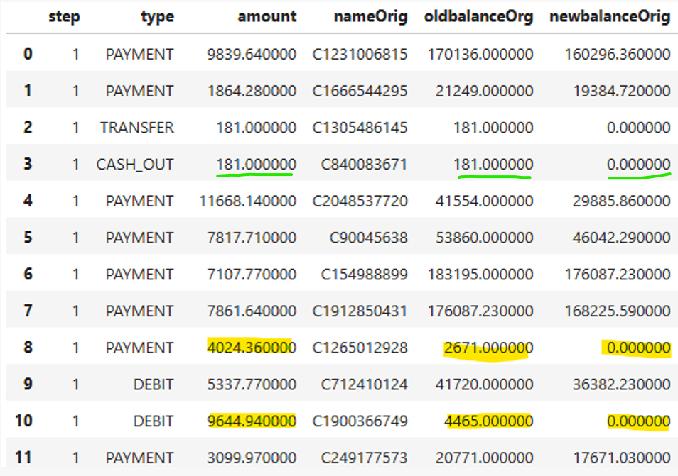
Transacted Amount discrepancies
Created new features below.
balance_change_orig :
(old balance – new balance)
is_account_drained : Whether the sender’s account was emptied
real_balance : For cases that should have a negative value. (balance change – transacted amount)

Slide 12
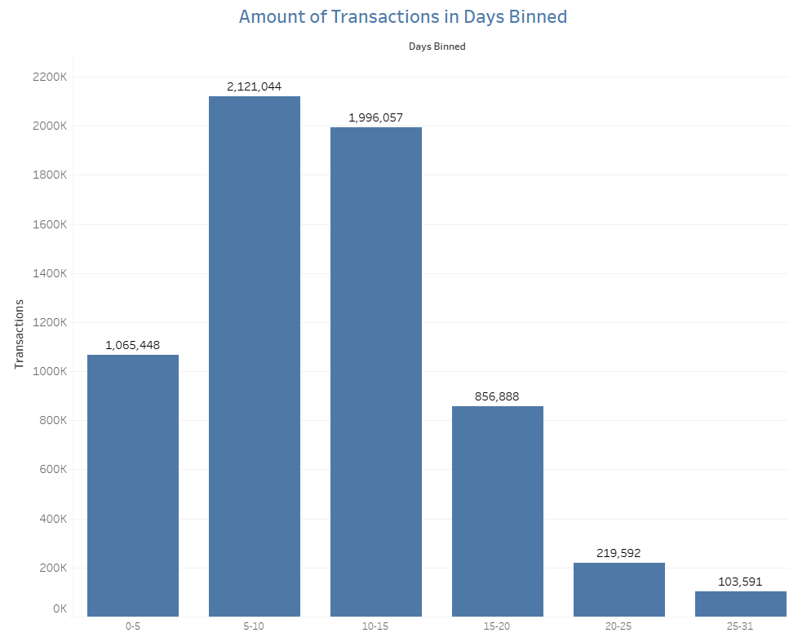
Amount of Transactions in Days binned
Days binned to 0-5, 5-10 e.t.c
Helps to see which period of the month has the highest transactions

Slide 13
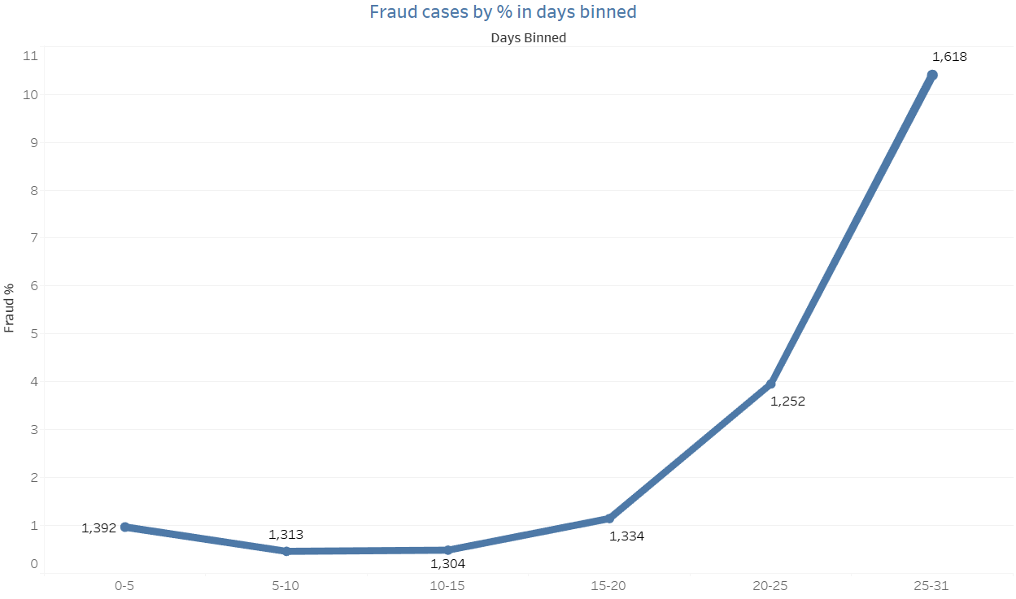
fraud rate in days binned
Frauds happens more frequently at the end of the month

Slide 14
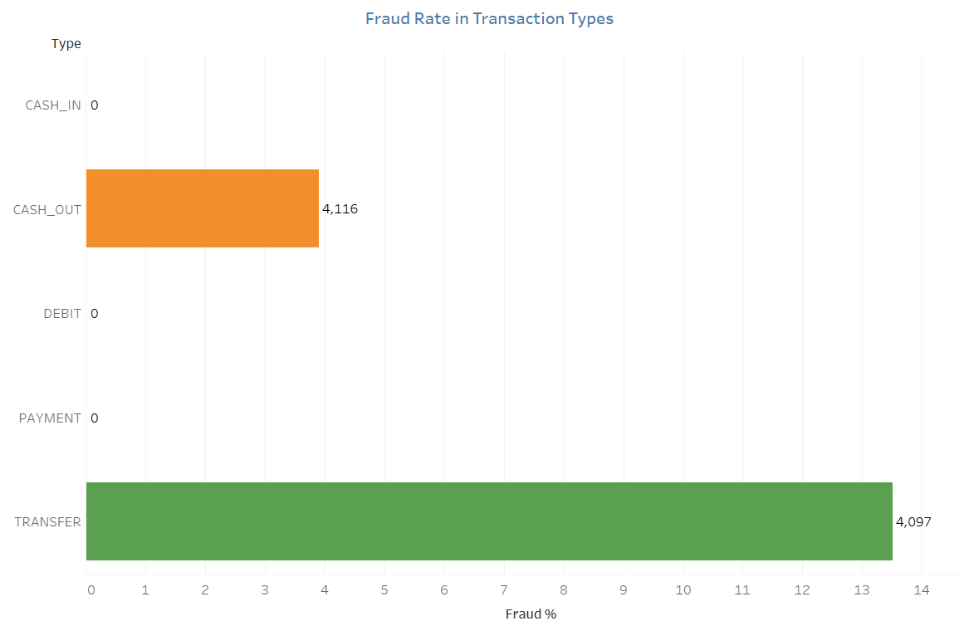
Fraud Rate in Transaction Types
Fraud only occurs in Cash_Out and Transfer
4% of Cash_Out are fraud
13.5% of Transfer are fraud.

Slide 15
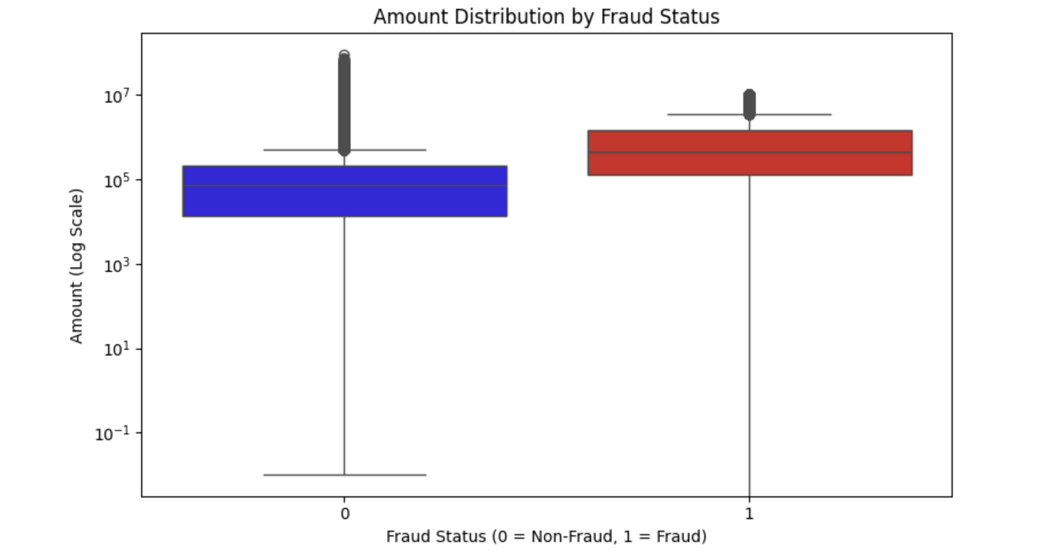
Amount Distribution by Fraud Status
Focus more on the Fraud cases
Frauds transaction are more common from the 100k to 10million

Slide 16
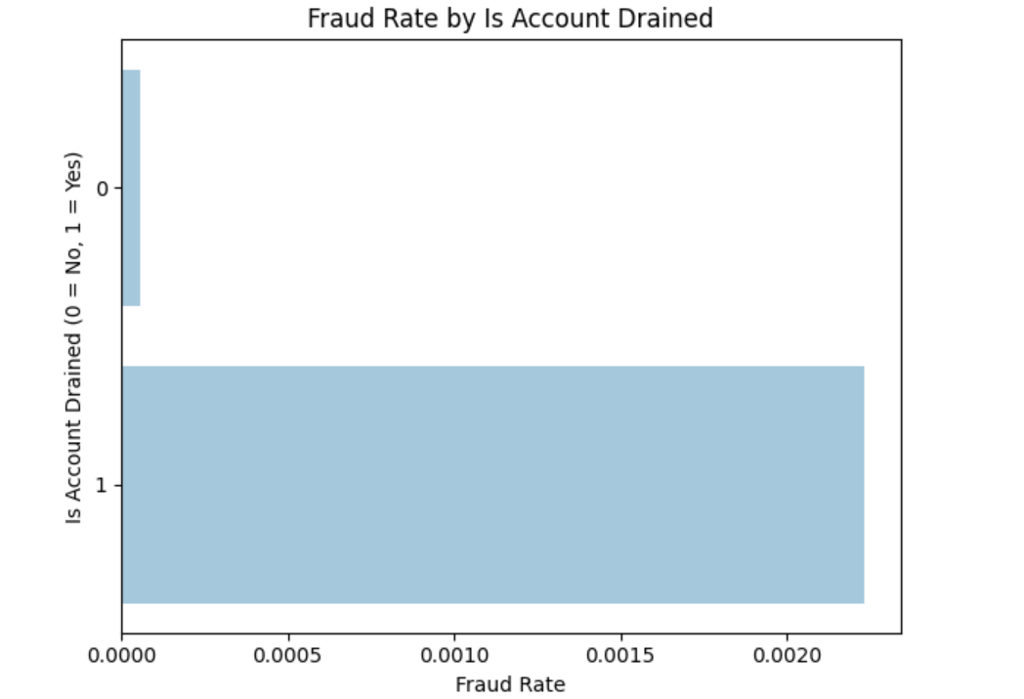
Fraud Rate by Account Drained
Theres a much higher chance fraud occurs when ‘account is drained’

Slide 17
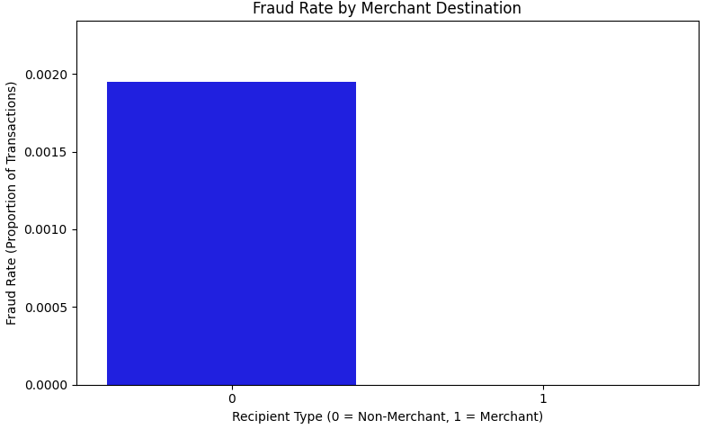
Fraud Rate by Non-Merchant
Fraud only occurs to normal customers instead of Merchants

Slide 18
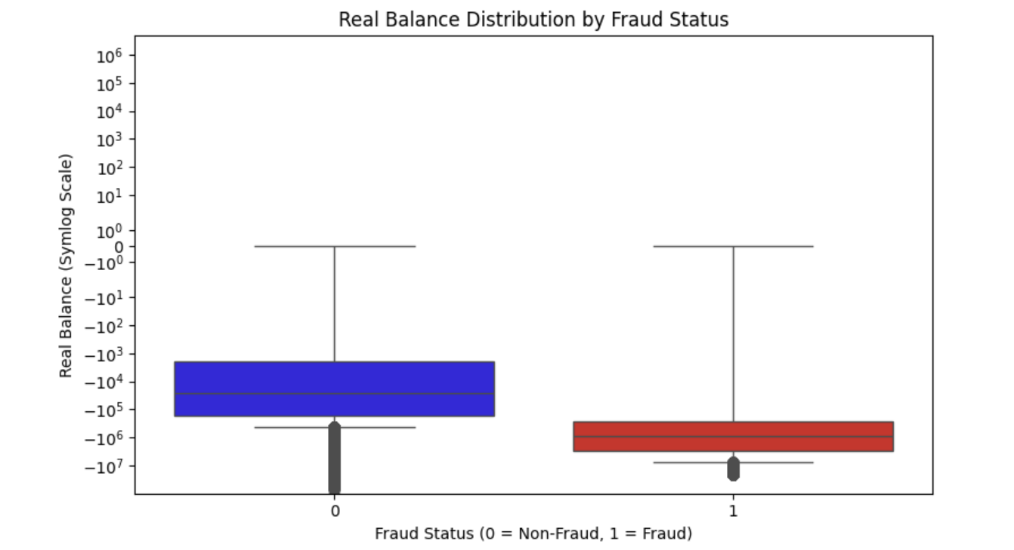
Real Balance by Fraud Status
Fraud occurs more frequently when balance is negative 100k to 10million

Slide 19
Summary
Based on the Investigation against the Target Variable, isFraud, we have identified :
Fraud happens more frequently at the end of the month
It happens only in transaction type Cash_out and Transfer
When it involves large transaction amounts
Highly chance when the account is drained
When the transaction is made by a non-merchant
When the Real balance is not $0 but a high negative total sum

Slide 20
MODELLING & EVALUATION

Slide 21
Metrics
Metrics | Objective | Target
Recall | Accurately identify most fraud cases | ≥ 70%
F1-Score | Balance precision and recall to effectively identify fraud while minimizing false positives and negatives | ≥ 70%

Slide 22
Modelling
Models
Training and Hyperparameters
Logistic Regression – Baseline Model
Logistic Regression (threshold 90%)
Random Forest
Train test split of 80-20
Class_weight = balance
Adjust Threshold
N_estimators(random forest)

Slide 23
Modelling Results
 | Precision | Recall | F1-Score
Logistic Regression – Baseline | 74.82% | 51.73% | 61.17%
Logistic Regression (90% threshold) | 16.20% | 79.67% | 26.92%
Random Forest | 91.58% | 86.73% | 89.09%

Slide 24
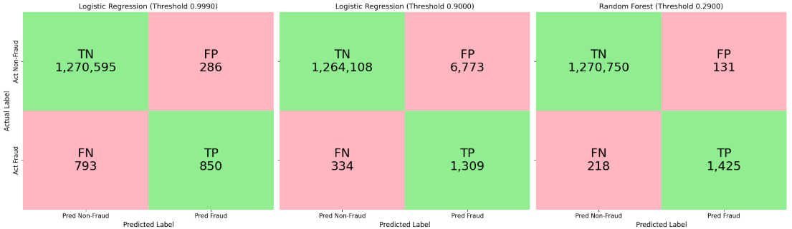
Confusion Matrix
0 is the negative class
Logistic Regression
Baseline
Logistic Regression
90% Threshold
Random Forest

Slide 25
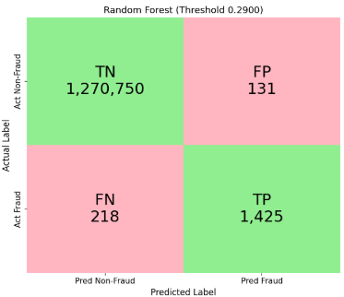
Conclusion
 | Precision | Recall | F1-Score
Random Forest | 91.58% | 86.73% | 89.09%
This model caught 1,425 of 1,643 fraud cases, missing only 218, and incorrectly flagged just 131 legitimate transactions.
This model had also minimizing customer disruption while maintaining high fraud detection.

Slide 26

Recommendations
We recommend companies adopt a Random Forest model, which caught 86% of fraud cases with only 131 errors
Focus on transaction type – CASH_OUT and TRANSFER
Include Transaction location data to further study where fraud occurs more frequently
Lastly, have a dataset of more than a year.

Slide 27
MANY THANKS!
Do you have any questions?
Please keep this slide for attribution

